Slide 1
BASIC ANGIOPLASTY TECHNIQUES
PROF. BIODUN ADEYINKA
DEPARTMENT OF RADIOLOGY
COLLEGE OF MEDICINE UNIVERSITY OF IBADAN

Slide 2
BASIC ANGIOPLASTY TECHNIQUES
Definitions & Objectives
  Indications for Procedure
    Patients’ Preparations
      Equipment
        Technique Proper
          After Procedure Care
            Complications
              Limitations
                Images

Slide 3
DEFINITION
Definition:
Minimally invasive Interventional procedure performed to open a narrowed or blocked blood vessel under an Image Guidance device. [ With or Without Stent Placement]
Principle of Technique:
Use of imaging techniques (Equip. with fluoroscopy device)
To guide a balloon-tipped catheter ( long, thin plastic tube) into an artery or vein
Pass across the area of vessel narrowing or blockage.
Balloon is inflated to open the vessel, then deflated and removed.
Stent (Wire mesh) may be placed to keep vessel permanently open

Slide 4
OBJECTIVES
Objectives:
To Open up Narrowed vessels (Arteries or Veins)
Improve blood flow when there is narrowing in the body's arteries or veins
Prevent Restenosis of Opened Vessels (Angioplasty + Stenting)

Slide 5
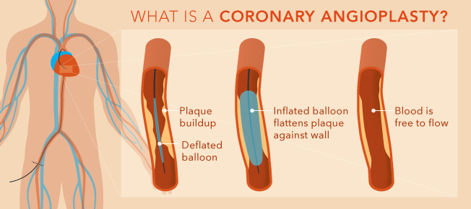
TYPES OF ANGIOPLASTY
Percutaneous Transluminal Coronary Angioplasty (PTCA)
Femoral Art. Aplasty.(PTFA)
Renal Artery Angioplasty (PTRA)
Fistula/Stent Graft Angioplasty
Popliteal Art (PTPA)
WIKIPEDIA

Slide 6
INDICATIONS
Atherosclerosis, narrowing of large arteries (aorta and its branches)
Peripheral artery disease (PAD), a narrowing of the arteries in the legs or arms.
Renal vascular hypertension, high blood pressure caused by Stenosis of the kidney arteries.
Carotid artery stenosis
Coronary artery disease
Dialysis and Fistula/Graft Declotting and Interventions

Slide 7
PATIENTS PREPARATION
Rule out Hx of allergy to Local, general anesthesia & contrast materials
Stop taking aspirin, nonsteroidal anti-inflammatory drugs (NSAIDs) or blood thinners prior to procedure.
R/O recent illnesses or medical conditions.
Rule out Pregnancy
Take usual medications, especially B/P medications.
4-6 hours fast.
Anticoagulants given prior to the procedure to prevent thromboses (blood clots).

Slide 8
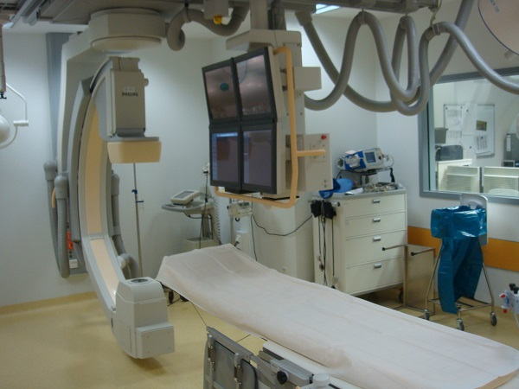
EQUIPMENT
Imaging Equipment with Fluoroscopy Device (Cath-Lab, DSA). Watch & Guide Procedure
Contrast Medium
Diagnostic Angiographic Catheters & Guidewires

Slide 9
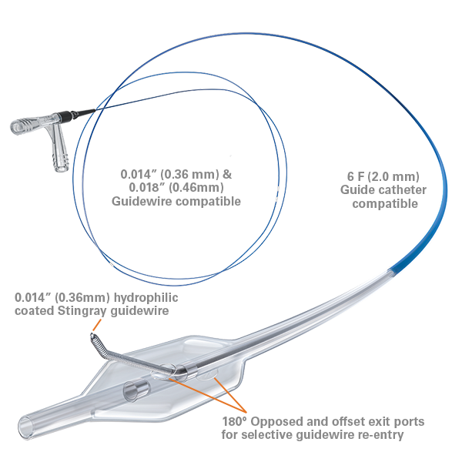
EQUIPMENT
Guide Wire:
To guide placement of the Angioplasty Balloon Catheter Diagnostic Catheter, & Vascular Stent.
2. Sheath
Vascular tube placed in the Access vessel allows catheter exchanges easily during these complex procedures.
WIKIPEDIA

Slide 10
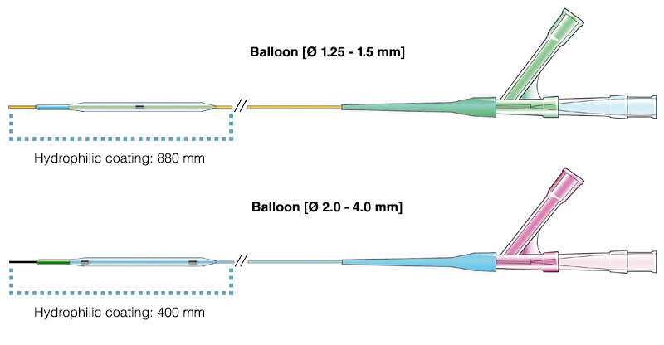
EQUIPMENT
3. Balloon catheter
Long, thin plastic tube with a tiny balloon at its tip. Varying sizes and Lengths
WIKIPEDIA

Slide 11
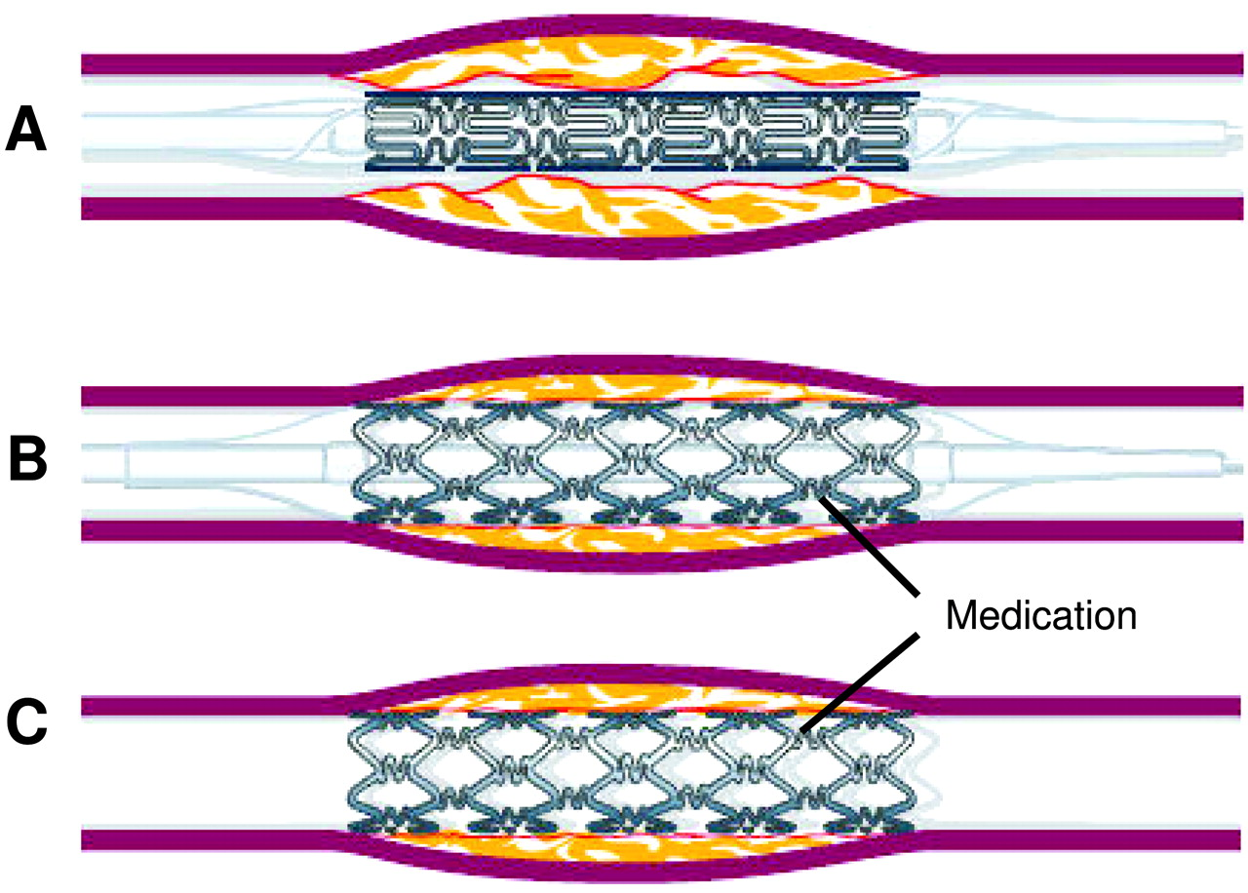
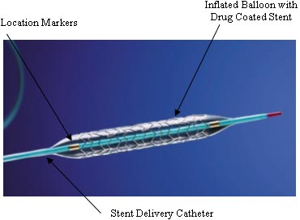
EQUIPMENT
4. Stents
Small, flexible tube made of plastic or wire mesh to support the damaged artery walls.
Balloon Expandable & Self- Expandable
Bare Stents & Covered Stents or Stent Grafts (Synthetic Fabric Covering)
Deployable: Collapsed on a catheter and then expanded inside the vessel to prop the walls open. In some cases, the stent may have a synthetic fabric covering.
WIKIPEDIA

Slide 12
TECHNIQUE PROPER
1. Done by a specially trained interventional radiologist in an interventional radiology suite
2. Positioned supine on the examining table.
3. Monitors: Heart rate, Blood pressure and pulse during the procedure.
4. Insert (IV) line for Sedative Medication:
5. Choose Preferred site of Puncture:
a. Brachial Artery/Vein – Antecubital/Radial art
b. Femoral Art/Vein – Groin/Femoral
6. Apply local anesthetic.
7. Small skin incision at site.
8. A sheath is first inserted into the artery, or vein

Slide 13
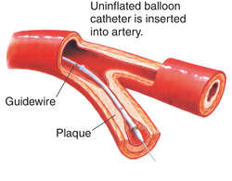
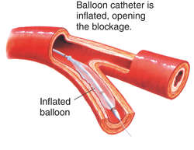
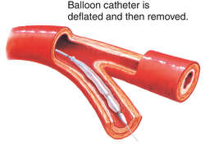
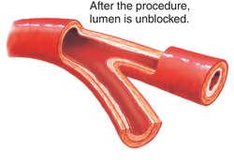
TECHNIQUE PROPER
9. Pass Angiographic Guidewire/Catheter under Image guidance followed by Angiogram
10. Pass Guidewire across site of blockage followed by Balloon Angioplasty Catheter to site
11. Inflate Balloon Cath until vessel is satisfactorily opened
12. Deflate Balloon, Remove Balloon Catheter
WIKIPEDIA

Slide 14
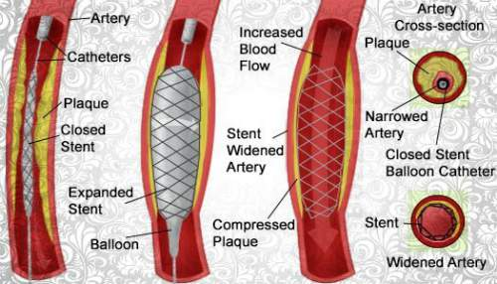
TECHNIQUE PROPER
13. Pass Angiographic Catheter and do Check Angiogram to ensure free blood flow across site of opened vessel
14. Placement of Stent via mounted on Balloon cath. Or Self expandable
15. Remove Angio. Cath and Sheath and secure Hemostasis at site of puncture.
WIKIPEDIA

Slide 15
TECHNIQUE PROPER
Complications:
Puncturing the vessel with the guidewire.
Hematoma or hemorrhage at puncture site.
Heart attack,
Emboli
Restenosis
Death- Unlikely

Slide 16
References
Dale K Mueller. Peripheral Vascular Stent Injection
George A. Stouffer. Percutaneous Coronary Intervention
WIKIPEDIA free Encyclopedia. Angioplasty and Vascular Stent
Debra Sullivan. Stent. Healthline.com/health/stent
WIKIPEDIA free Encyclopedia. Coronary Stent
Patrick J. Skerret. From the wrist to the Heart: new Angioplasty method is safe, effective

Slide 17
Thank You All
Task 2
Task 1
Group C

