Slide 1
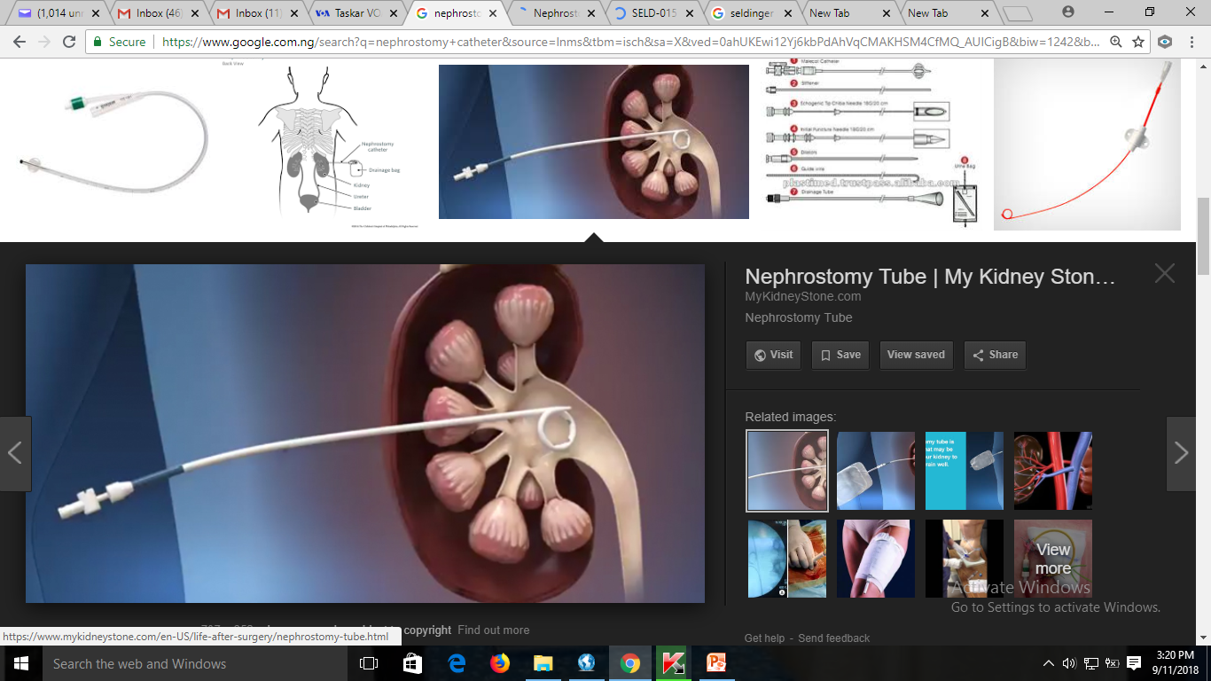
HOW I DO IT: PERCUTANEOUS NEPHROSTOMY
Anas ISMAIL FMCR
DEPT OF RADIOLOGY, BAYERO UNIVERSITY/AMINU KANO TEACHING HOSPITAL, KANO.
aismail.rad@buk.edu.ng
anas.ismail@npmcn.edu.ng
General secretary, NiSIR

Slide 2
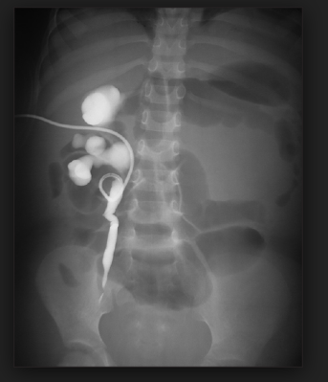
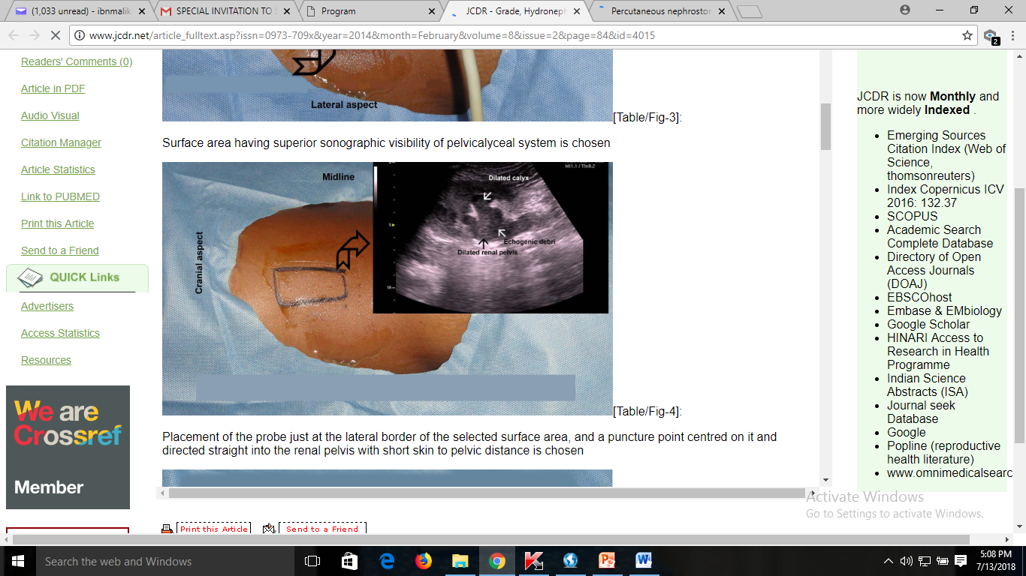
Percutanous Nephrostomy
Using Fluoroscopy
Using Ultrasound

Slide 3
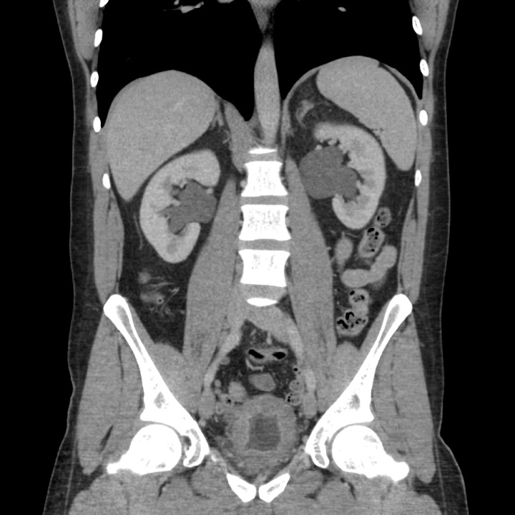
Indications
Relief of Urinary Obstruction
        Urosepsis or possible infection
        Acute Renal failure
Urinary Diversion
        Haemorrhagic cystitis
        Trauma or iatrogenic ureteral injury
        Inflammatory or malignant urinary fistula
Access for endourological procedure
        Dilating or stenting ureteral stricture
        Biopsy or treatment of urothelial lesions
        Foreign body retrieval

Slide 4
Who should do it?
Who should do it?
IR or Urologists?
It should be part of residency training
Not just a drainage….
When should it be done?
During the day
Possibly during the night for a single kidney or Sepsis

Slide 5
Contraindications
Absolute
Relative
? None…
Dying patient
Uncorrectable severe coagulopathy / bleeding diathesis
Severe hyperkalaemia and/or metabolic acidosis
Pregnancy

Slide 6
Equipment
1. Puncturing needle (18-G); Longdwell, or equivalent.
2. Drainage catheter: at least 7-F pigtail with multiple side holes.
3. Guide-wires: conventional angiographic and Lunderquist.
4. US and/or fluoroscopy.

Slide 7
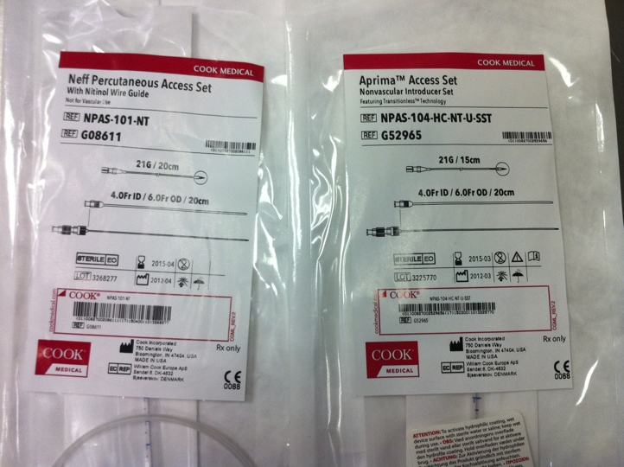

Access Kits

Slide 8
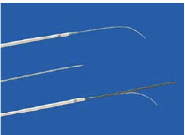
KIT
  18 needle
  Some sort of micropuncture kit
      Eg Neff Set
        22gu access needle
        Platinum tipped 018 wire
        4Fr catheter and metal stiffener
        Outer 7Fr catheter
  Ultrasound probe cover
  Local – 1% lignocaine
  Iodinated contrast and extension tube
  Metal wire e.g. amplatz super stiff, J or Bentson
  Dilate to 1Fr > than intended nephrostomy drain
    6-8Fr.
    Drainage bag

Slide 9
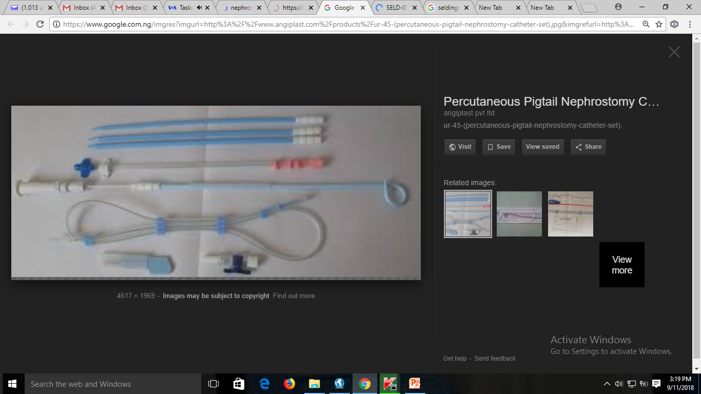
Typical nephrostomy set

Slide 10
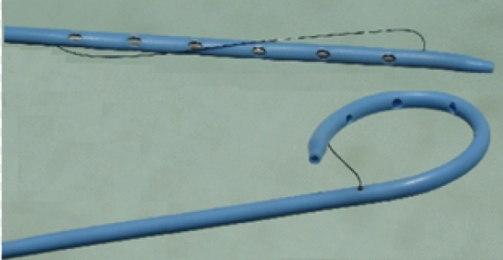
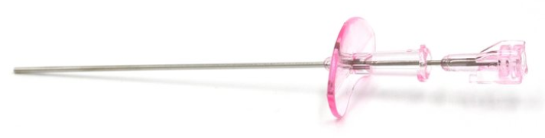

Slide 11
Patient preparation
1. Fasting for 4 h
2. Premedication
3. Prophylactic antibiotic
4. Surgical backup in view of clinical workup, possible complications and further management

Slide 12
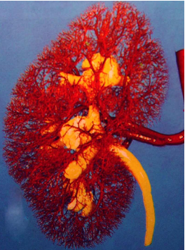
Patient Preparation
Bloods…..
Bleeding Risk Assessment
Evidence of coagulopathy
Is the patient on warfarin
  FBC – plts >50 x 10⁹
  INR - <1.5
Hyperkalaemia
  K >6.5 – call your medic / anesthetist. Can the patient be dialysed?
Notes:
Lying prone increases hypoventilation and therefore worsens the metabolic acidosis.

Slide 13
Technique
Patient position
With the patient lying in the prone position on the fluoroscopic table, a foam pad or non-opaque pillow is placed under the abdomen so that the kidney lies in a fixed posterior position.
An oblique position with the kidney to be punctured raised is sometimes used.
Identifying the collecting system
Real-time US may be used to identify the renal pelvis for antegrade pyelography and to determine the plane of definitive puncture of the collecting system.

Slide 14
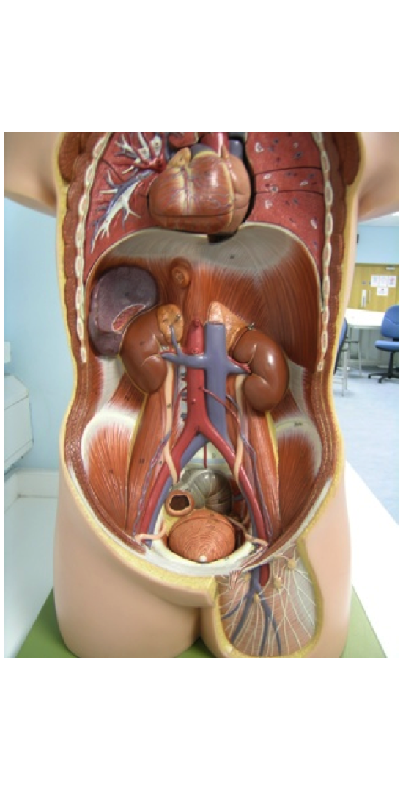
Where to Puncture?
Considerations:
  Anatomy – Where am I least likely to cause significant complications
    Bleeding
    Perforation
    Pneumothorax
  Next intervention
    Simple nephrostomy
    Ureteral intervention
  Patient comfort

Slide 15
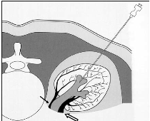
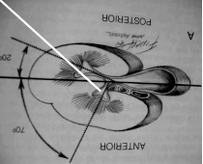
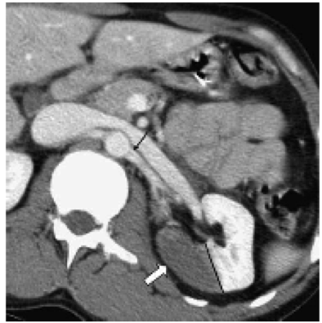
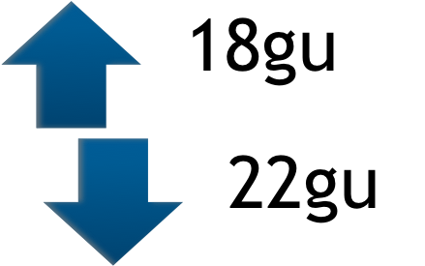
Bleeding
Renal artery divides into anterior an posterior branches
Posterior branch supplies 30% of the kidney
Brodel’s Line divides the area between the anterior and posterior division
  RELATIVELY AVASCULAR

Slide 16
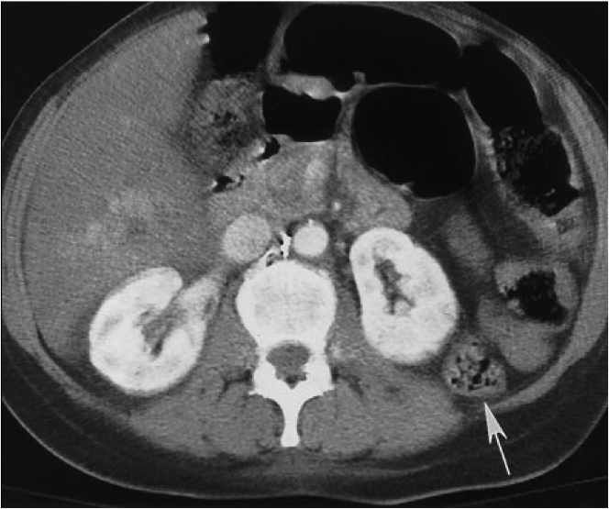
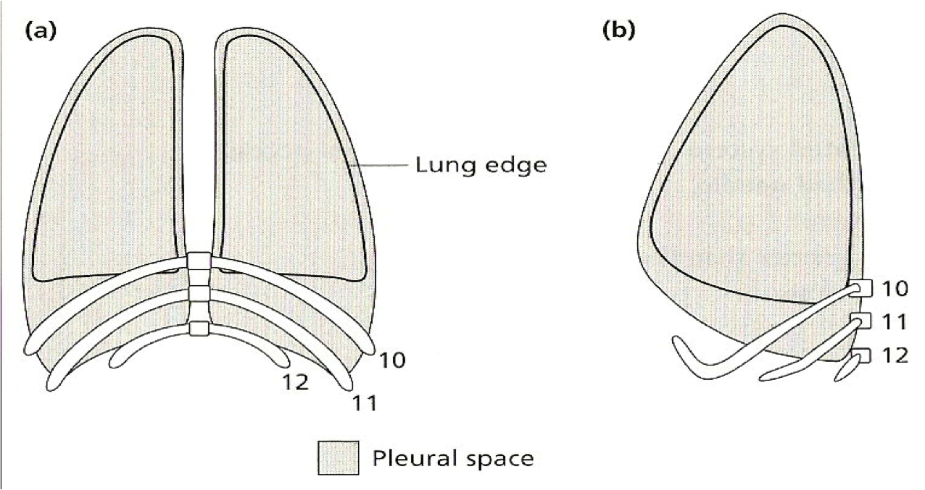
Other anatomical considerations
  BOWEL
LUNG

Slide 17
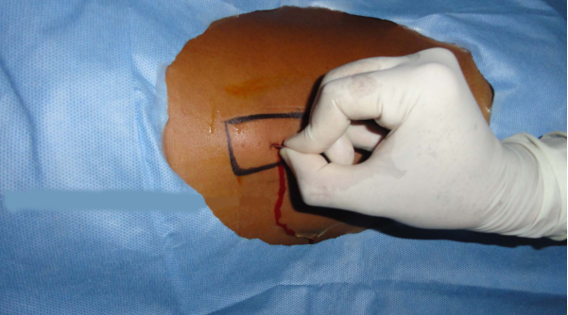
Site/plane of puncture
A point on the posterior axillary line is chosen below the twelfth rib.
Having identified the mid/lower pole calyces with contrast/US, the plane of puncture is determined.
The drainage catheter is also more comfortable for the patient in this plane, and is less likely to be kinked when he/she lies supine.

Slide 18
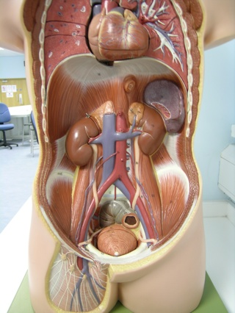
Upper pole Puncture
  May be easier for stenting but risks pleural transgression
Interpolar region
  Reasonably safe, good for antegrade ureteric work
Lower pole
  Safe. Simple for nephrostomy, may be harder for ureteric access

Slide 19
Techniques of puncture, catheterization
The skin and soft tissues are infiltrated with local anaesthetic using a spinal needle. Puncture may then be made using one of the following systems (depending on preference):
  An 18-G sheathed needle, a cyst puncture or a Longdwell needle, in conjunction with the Seldinger technique for catheterization.
  Upon successful puncture a J guide-wire is inserted and coiled within the collecting system; the sheath is then pushed over the wire, which is exchanged for a more rigid Lunderquist wire. If possible the guide-wire is manipulated into the ureter.
  Dilatation is then performed to 1-F greater than the size of the drainage catheter, which is then inserted. During all manipulation, care must be taken not to kink the guide-wire within the soft tissues.
  A substantial amount of guide-wire should be maintained within the collecting system so that position is not lost and if kinking does occur, then the kinked portion of the wire can be withdrawn outside the skin.
Having successfully introduced a catheter, the latter is securely fixed to the skin and drainage commenced.

Slide 20
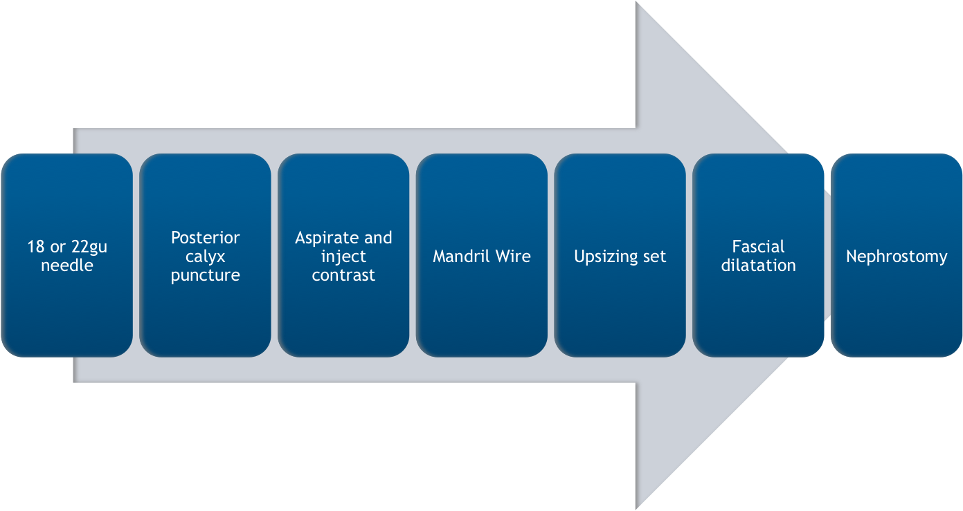
Single Stick Technique

Slide 21

Complications
Major (<5%)
Septic Shock 1-3% ( <10% if pyonephrosis)
Haemorrhage
1-4%
Bowel Transgression
<1%
Pleural Complications
<1%

Slide 22
Complications of percutaneous nephrostomy and related procedures
During a 10-year period 341 patients were reviewed after for percutaneous nephrostomy and/or percutaneous insertion of a ureteral endoprosthesis, and a total of 1036 interventional procedures were performed (nephrostomy, catheter change, stenting).
RESULTS:
There were three major complications (0.29%): two patients died during the first 30 days after the procedure, due to aggravation of their condition caused by the procedure, and one patient had retroperitoneal bleeding requiring surgery.
There were 76 complications of intermediate severity (7.33%): catheter or stent displacement (n = 37, 3.57%)
catheter occlusion (n = 18, 1.73%),
hematuria (n = 12, 1.16%),
and urinary tract infection (n = 9, 0.87%).
The 55 minor complications (5.3%) comprised inflammation of the skin at the site of insertion of the percutaneous catheter.
Cardiovasc Intervent Radiol. 2001 Jul-Aug;24(4):224-8.

Slide 23
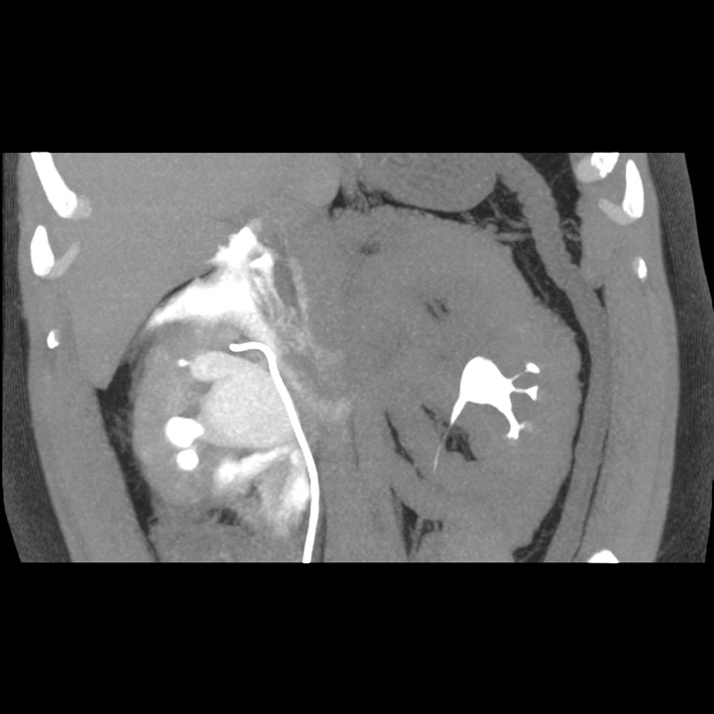

Slide 24
SIR classification
  MINOR
    A no therapy or consequence
    B nominal therapy, no consequence, overnight admission for observation only
  MAJOR
    C therapy , minor hospitalisation <48 hrs
    D major therapy, increased care, prolonged hospitalisation >48hours
    E permanent adverse sequelae
    F death

Slide 25
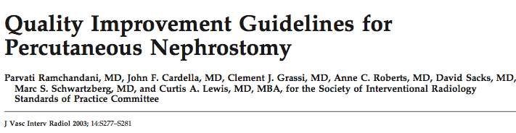
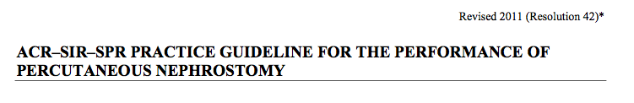
Success Rates
Obstructed Dilated system without stones 95-98%
Non-dilated collecting system 80-85%

Slide 26
Post Procedural Care
Bed Rest for 4hours
Obs – Bp/Pulse 30min for 4 hrs
Temperature

Slide 27
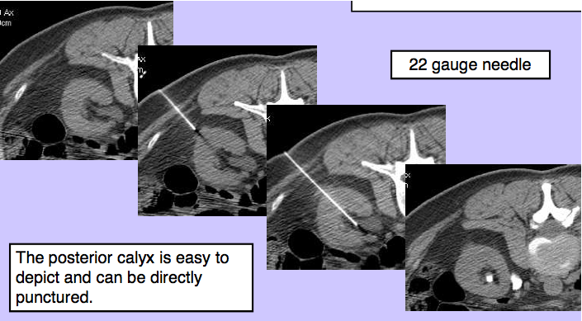
CT guided

Slide 28
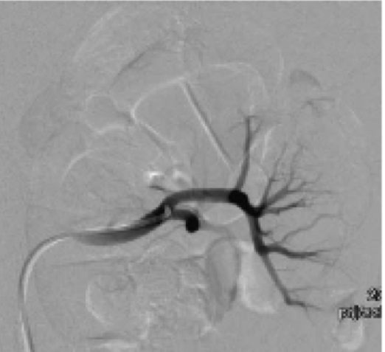
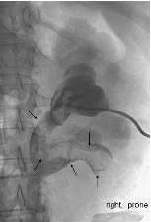
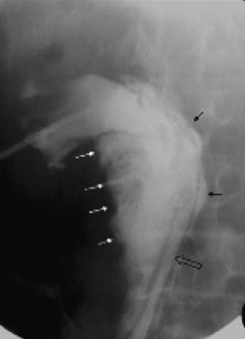
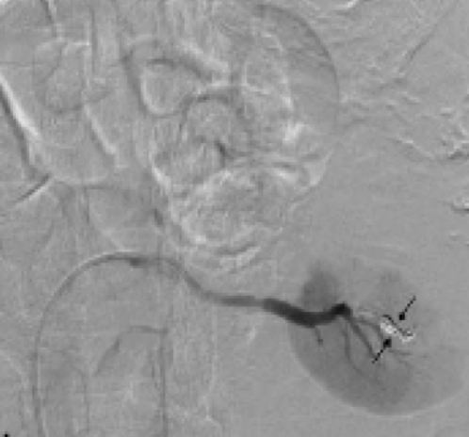
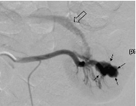
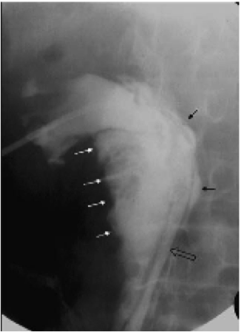
Complications

Slide 29
Success Rates
Obstructed Dilated system without stones 95-98%
Non-dilated collecting system 80-85%

Slide 30
Special precautions
To minimize complications,
Preprocedural evaluation of the patient, with correction of marked coagulopathy or thrombocytopenia.
Antibiotics should be administered routinely before nephrostomy drainage; the choice of antibiotics can be based on the specific patient's risk factors for bacteriuria.

Slide 31
Special precautions-2
To minimize the risk of clinically important renal vascular damage, radiologists should do the following:
1. Always achieve adequate visualization of the calices.
2. Identify a posterior calix for puncture that will give access to the appropriate segment of the kidney for anticipated procedures and allow safe creation of a tract.
3. Puncture below the 11th rib (and preferably below the 12th rib when feasible).
4. Puncture the tip of a posterior calix from a 20⁰ -30⁰, posterolateral oblique approach to avoid major blood vessels.
5. Make a single-wall puncture of the calix.

Slide 32
Special precautions-3
Overdistention can increase the likelihood of sepsis or retroperitoneal contamination.
Inject contrast material via a catheter placed over a wire to confirm the intracollecting system location of the entry.
Avoid unnecessary (prolonged) procedures in an infected, obstructed system.
Use only self-retaining drainage catheters to minimize the risk of inadvertent catheter dislodgment.
Create large-bore tracts with a balloon dilation system.
Do not puncture above the 11th rib (unless all other avenues of approach have been exhausted).

Slide 33
INDICATIONS OF PCN IN AKTH
M:F= 13:7
AGE RANGE= 25-86
MEAN AGE= 53.4 YEARS

Slide 34
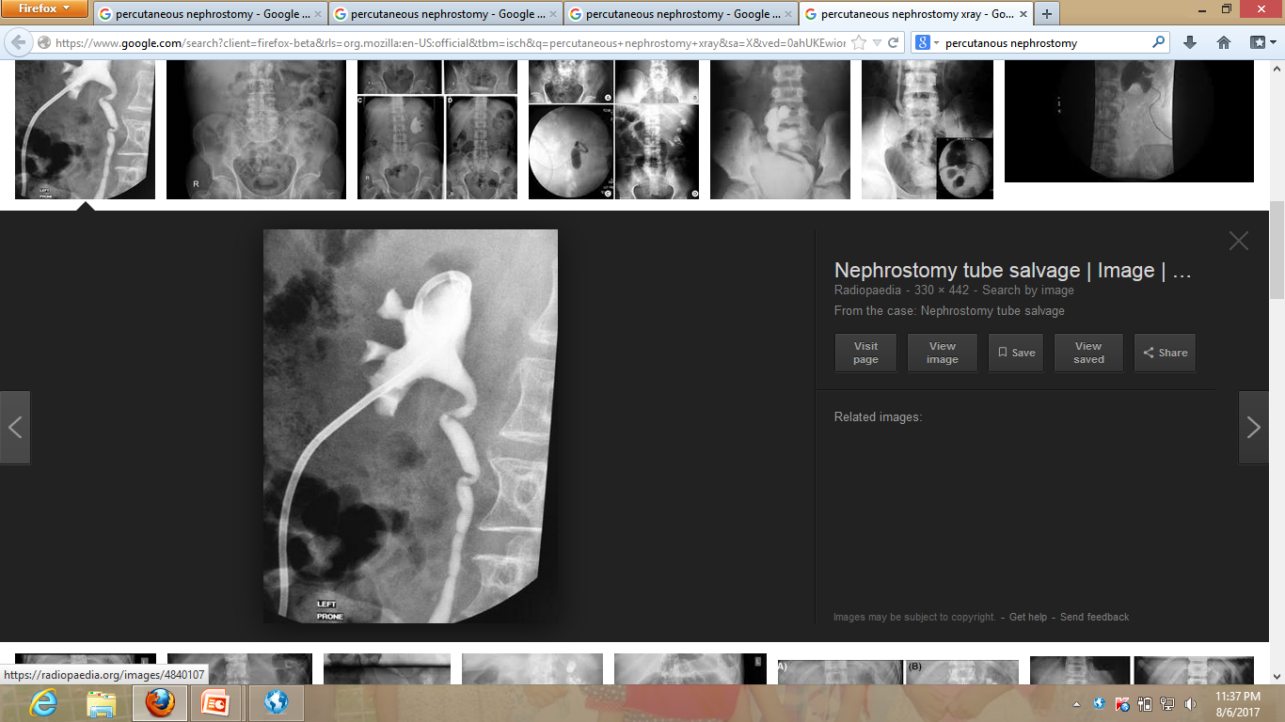
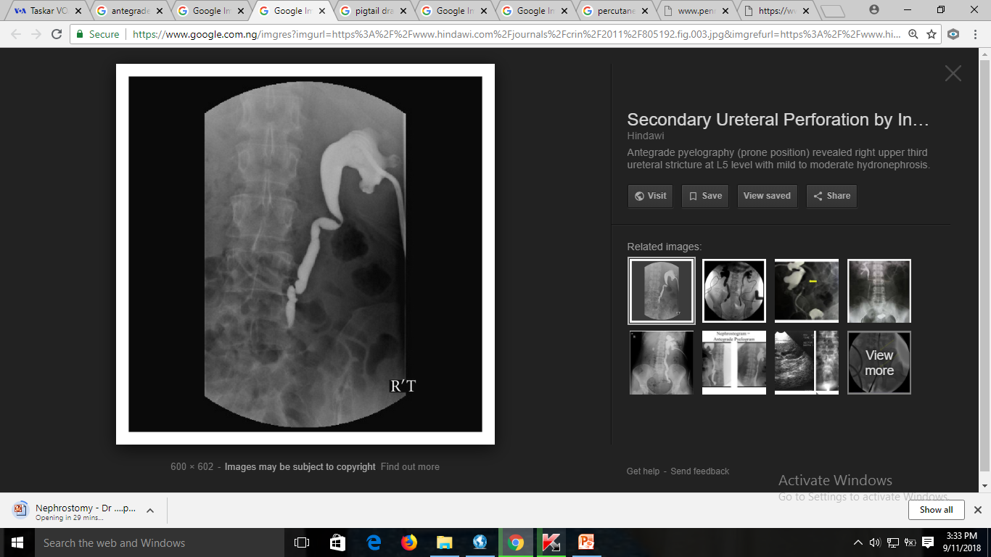
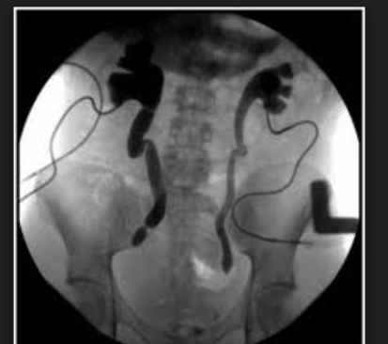

Slide 35
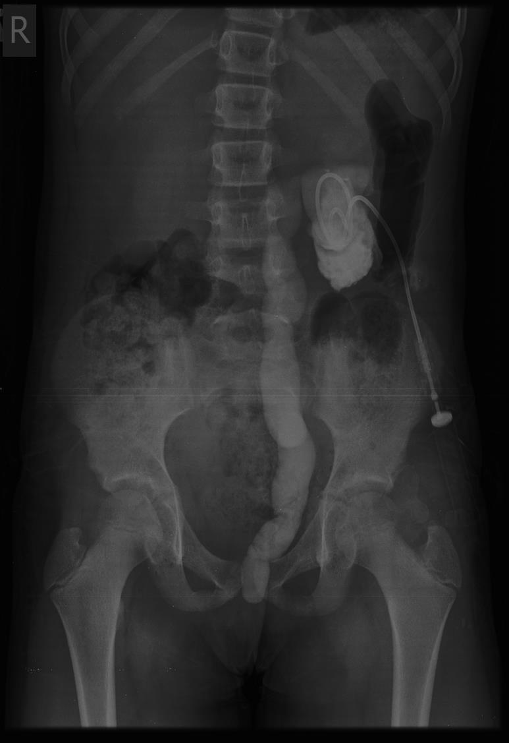
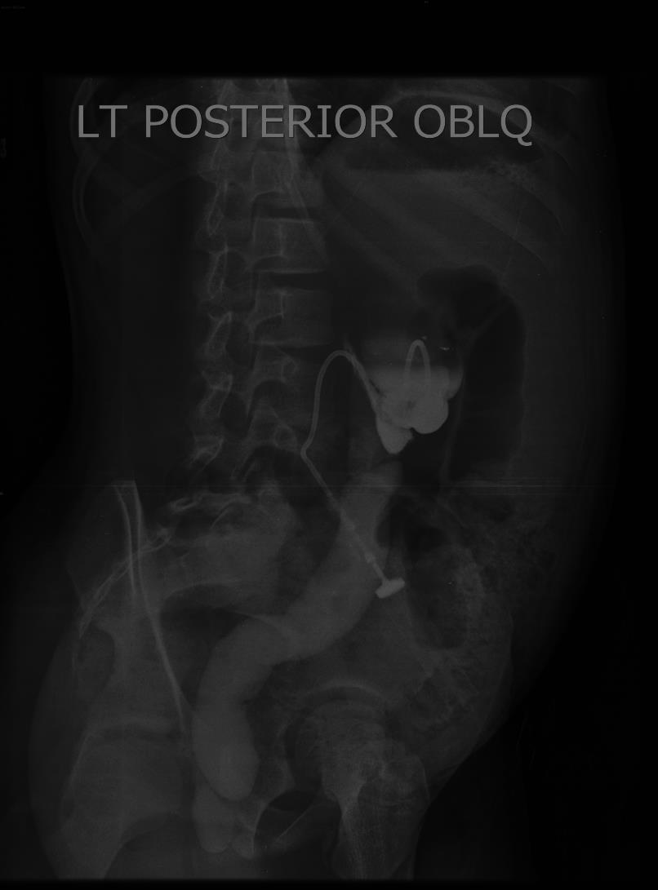
Rare indications of PCN

Slide 36
Bail out-1
Do not lose access to an obstructed kidney once the kidney has been punctured. Placement of a "safety" wire for all complex manipulations is recommended.
Do not panic if excessive bleeding or evidence of adjacent organ injury is seen. Excessive bleeding usually can be stopped with tract tamponade by using a balloon catheter advanced through the tract or with placement of an appropriate-sized nephrostomy tube to occlude the tract.

Slide 37
Bail out-2
If active bleeding continues or recurs, arteriography should be considered.
The quantity of bleeding can be monitored with sequential hematocrit measurements.
Almost all renal artery injuries can be treated with minimally invasive procedures, such as selective embolization of the branch artery involved, and this will lead to infarction of only a small segment of kidney, with preservation of functioning renal parenchyma.

Slide 38
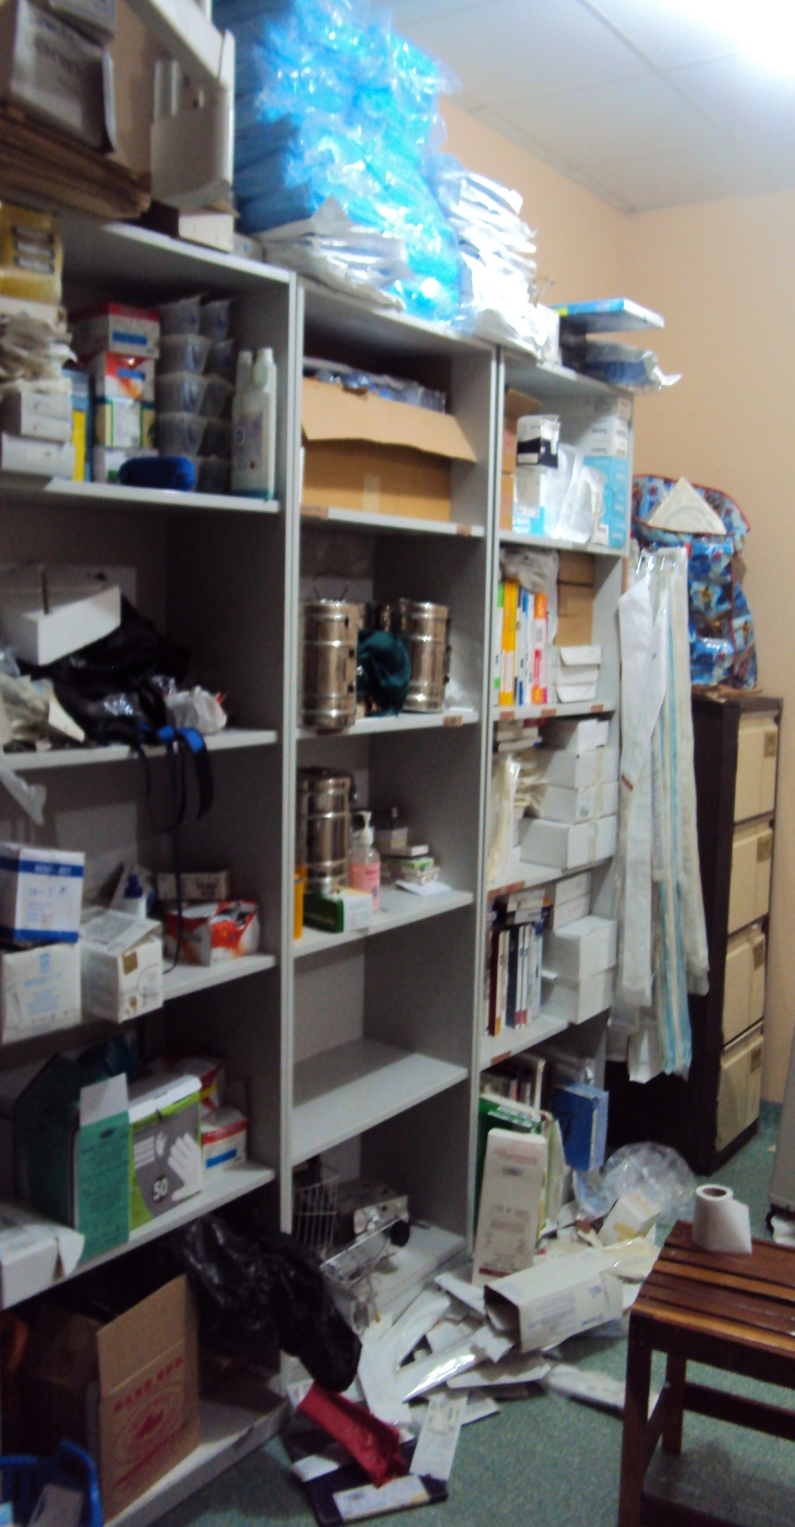
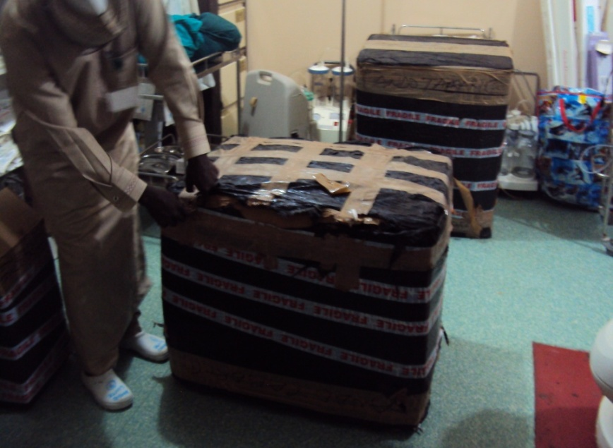
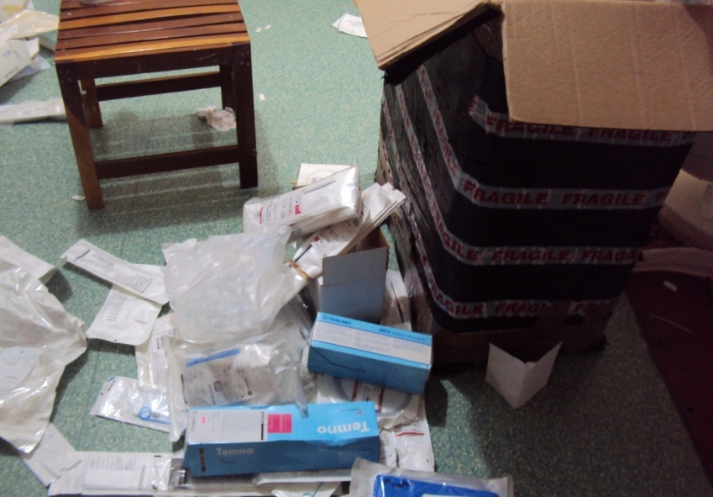
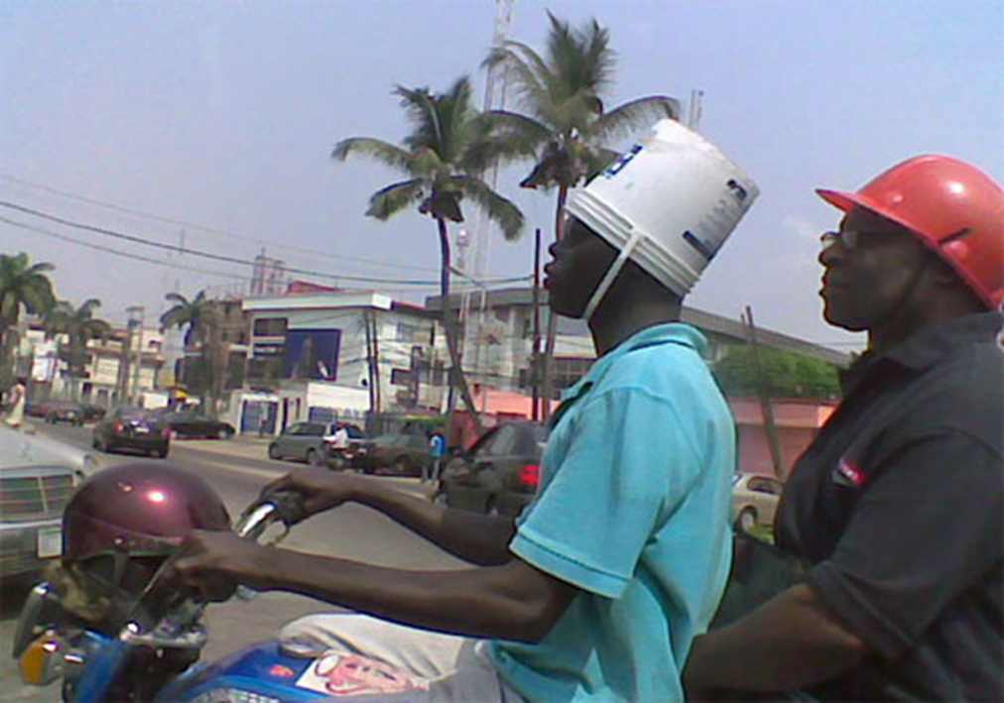
Challenges
Supply of Consumables
Thanks to Dr Mark Thompson from Bristol

Slide 39
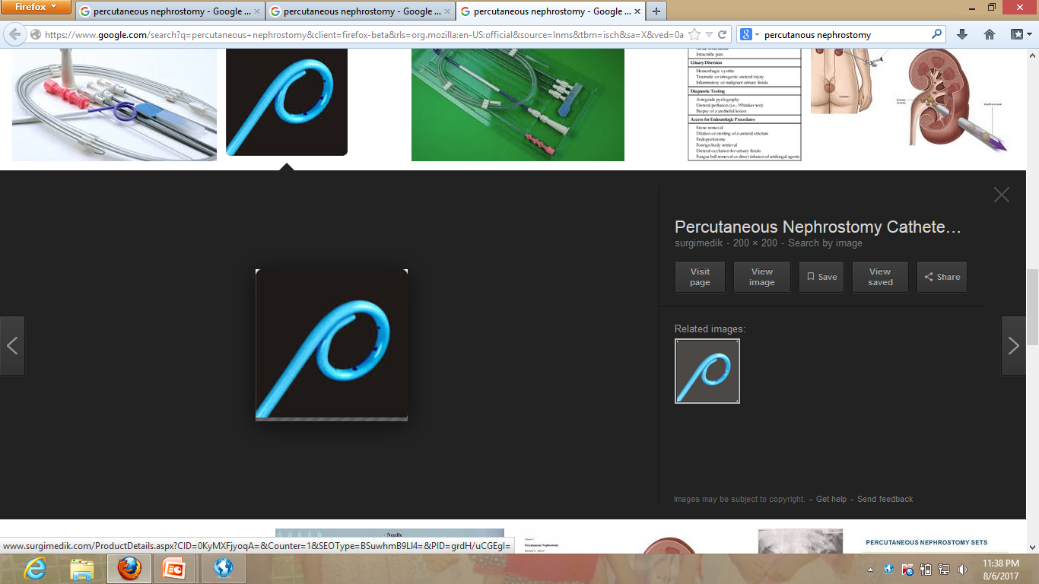
Improvising Nephrostomy set

Slide 40
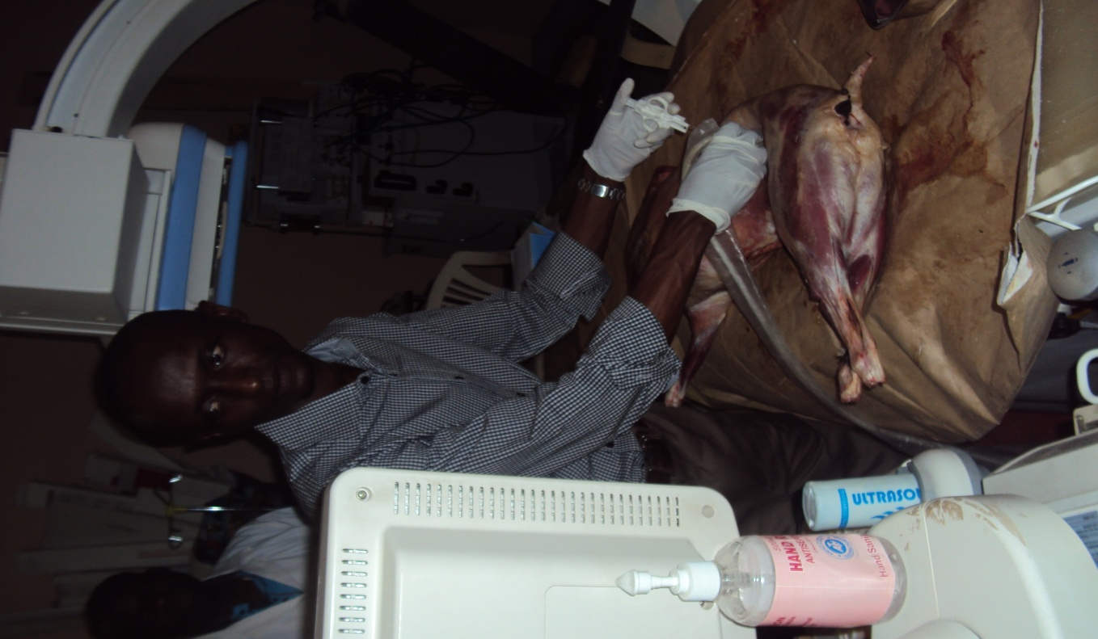
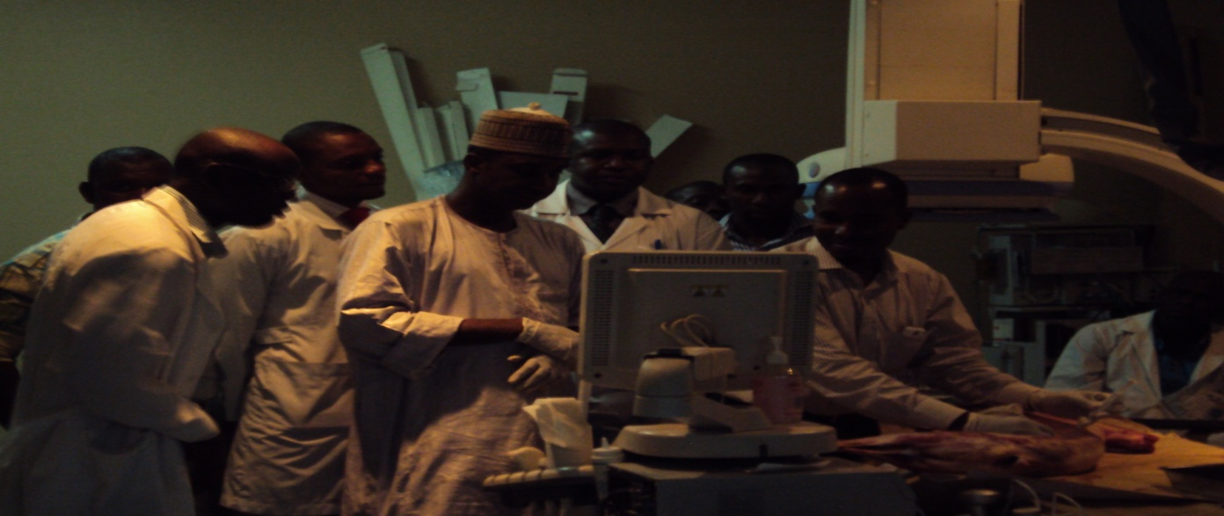
Overcoming challenge in training in image-guided procedures

Slide 41
Take home messages
PCN is a simple, often a life-saving procedure.
There is a great potential to consrve renal function.
In our center, it has significantly reduce the need for haemodialysis from obstructive uropathy.
Simple basic tools can be improvised

Slide 42
THANK YOU SO MUCH

